Slide 1
EM알고리즘을 이용한 기계부품의 고장 원인 및 신뢰성 분석
정나미, 손병관, 박찬석
부산대학교 산업공학과
2022 KSME Annual 학술대회

Slide 2
Introduction
Competing risk model
Purpose of study
- EM vs BFGS(Newton Raphson)
Method
MLE
EM
Applications
2 Failure modes
3 Failure modes
Conclusion
Further work
Contents

Slide 3
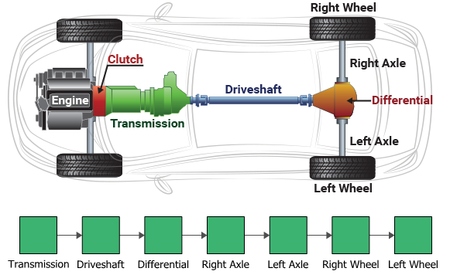
Introduction
- Competing risk models
Purpose of study
- EM vs BFGS
Method
– MLE / EM
Applications
- 2 Failure modes / 3 Failure modes
Conclusion
A system in series has several components.
http://www.ssacstat.com/base/cs/cs_05.php?topmenu=5&left=5
Department of Industrial Engineering,
Pusan National University
EM알고리즘을 이용한 기계부품의 고장 원인 및 신뢰성 분석
/ 14
Notes:
https://www.yna.co.kr/view/AKR20190603056100063
https://news.sktelecom.com/12252

Slide 4
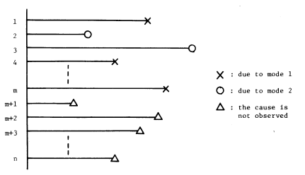
Introduction
- Competing risk models
Purpose of study
- EM vs BFGS
Method
– MLE / EM
Applications
- 2 Failure modes / 3 Failure modes
Conclusion
Competing risks models
The failure of the whole system is caused by the earliest failure of any of the components, which is commonly referred to as competing risks.
Assumption - Weakest link theory
A1
A2
The material contains inherently many strength-limiting defects, and its strength depends on the weakest defect of all of them.
There are no interactions among the defects.
Park, C. S. and Padgett, W. J., (2006) Analysis of strength distributions of multi-modal failures using the EM algorithm, Journal of Statistical Computation and Simulation, 76(6), pp. 619~636.
M. Miyakawa, (1984) Analysis of Incomplete Data in Competing Risks Model, IEEE Transactions on Reliability, vol. R-33, no. 4, pp. 293-296.
Department of Industrial Engineering,
Pusan National University
EM알고리즘을 이용한 기계부품의 고장 원인 및 신뢰성 분석
/ 14
Notes:
https://www.yna.co.kr/view/AKR20190603056100063
https://news.sktelecom.com/12252

Slide 5
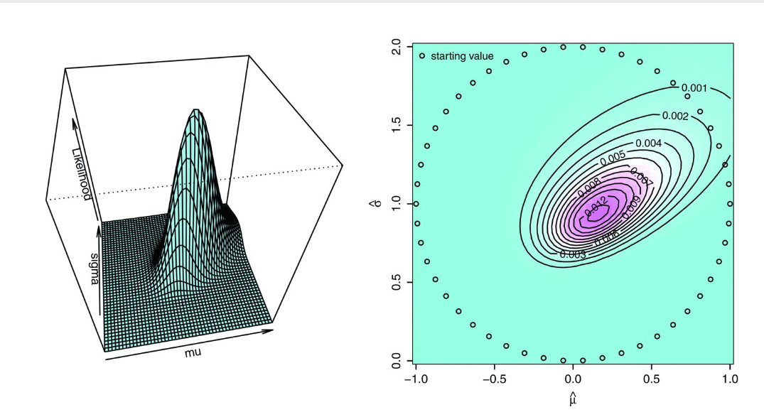
Introduction
- Competing risk models
Purpose of study
- EM vs BFGS
Method
– MLE / EM
Applications
- 2 Failure modes / 3 Failure modes
Conclusion
Illustration: Likelihood function with two parameters(Lognormal example)
(a) Contour plot
(b) Contour line
Park C. (2013) Parameter estimation from load-sharing system data using the expectation–maximization algorithm. IIE Transactions.;45(2):147.
Department of Industrial Engineering,
Pusan National University
EM알고리즘을 이용한 기계부품의 고장 원인 및 신뢰성 분석
/ 14

Slide 6
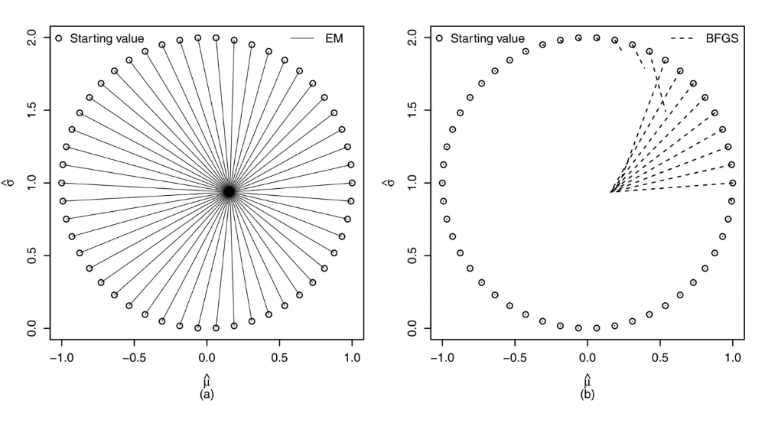
Introduction
- Competing risk models
Purpose of study
- EM vs BFGS
Method
– MLE / EM
Applications
- 2 Failure modes / 3 Failure modes
Conclusion
Illustration: Likelihood function with two parameters(BFGS에서 초기값의 영향)
(a) Contour plot
(b) Contour line
(c) Diagram of paths connecting the starting value and two estimates
Department of Industrial Engineering,
Pusan National University
EM알고리즘을 이용한 기계부품의 고장 원인 및 신뢰성 분석
/ 14

Slide 7
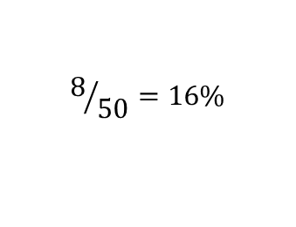
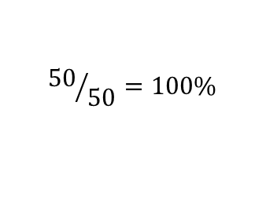
Introduction
- Competing risk models
Purpose of study
- EM vs BFGS
Method
– MLE / EM
Applications
- 2 Failure modes / 3 Failure modes
Conclusion
Illustration: Convergence of EM and BFGS(Newton-Raphson-type) estimation
The EM algorithm was introduced by Dempster et al.(1977) to overcome the difficulty.
$${50}/{50}=100\%$$
$$8/{50}=16\%$$
Park C. (2013) Parameter estimation from load-sharing system data using the expectation–maximization algorithm,.IIE Transactions. 45(2), 147.
Dempster, A. P., N.M. Laird, and D. B. Rubin (1977) Maximum likelihood from incomplete data via the EM algorithm. Journal of the Royal Statistical Society B 39, 1-22.
Department of Industrial Engineering,
Pusan National University
EM알고리즘을 이용한 기계부품의 고장 원인 및 신뢰성 분석
/ 14
Notes:
https://www.yna.co.kr/view/AKR20190603056100063
https://news.sktelecom.com/12252

Slide 8


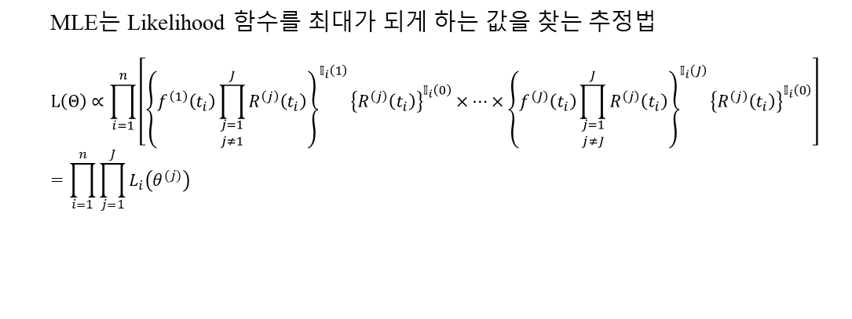









Introduction
- Competing risk models
Purpose of study
- EM vs BFGS
Method
– MLE / EM
Applications
- 2 Failure modes / 3 Failure modes
Results
X
O
O
Likelihood function with competing risk model
Case 1.
$$f^{(1)}$$
$$R^{(2)}$$
$$R^{(3)}$$
MLE는 Likelihood 함수를 최대가 되게 하는 값을 찾는 추정법
$$L\left(Θ\right)∝\prod_{i=1}^{n}{\left[{\left\{f^{\left(1\right)}\left(t_{i}\right)\prod_{\begin{aligned}j=1 \\ j≠1\end{aligned}}^{J}{R^{\left(j\right)}\left(t_{i}\right)}\right\}}^{𝕀_{i}\left(1\right)}{\left\{R^{\left(j\right)}\left(t_{i}\right)\right\}}^{𝕀_{i}\left(0\right)}×⋯×{\left\{f^{\left(J\right)}\left(t_{i}\right)\prod_{\begin{aligned}j=1 \\ j≠J\end{aligned}}^{J}{R^{\left(j\right)}\left(t_{i}\right)}\right\}}^{𝕀_{i}\left(J\right)}{\left\{R^{\left(j\right)}\left(t_{i}\right)\right\}}^{𝕀_{i}\left(0\right)}\right]}$$
$$=\prod_{i=1}^{n}{\prod_{j=1}^{J}{L_{i}\left(θ^{(j)}\right)}}$$
O
X
O
Case 2.
$$R^{(1)}$$
$$f^{(2)}$$
$$R^{(3)}$$
O
O
X
Case 3.
$$R^{(1)}$$
$$R^{(2)}$$
$$f^{(3)}$$
O
O
O
Case 4.
$$R^{(1)}$$
$$R^{(2)}$$
$$R^{(3)}$$
System states by four cases(System failure: Case:1, 2, 3, System Censoring case:4)
Department of Industrial Engineering,
Pusan National University
EM알고리즘을 이용한 기계부품의 고장 원인 및 신뢰성 분석
/ 14
Notes:
사용자 위치를 N 분할을 이용한 예측
Step 1 A=1 → ($\frac{1}{2},\frac{1}{2}$) (사각형의 중심 좌표, Cell 개수 = $1^{2}$ )
Step 2 A=2 → ($\frac{1}{4},\frac{1}{4}$), ($\frac{3}{4},\frac{1}{4}$), ($\frac{1}{4},\frac{3}{4}$), ($\frac{3}{4},\frac{3}{4}$) Cell 개수 = $2^{2}$
Step 3 A=3 → ($\frac{1}{6},\frac{1}{6}$), ($\frac{1}{6},\frac{3}{6}$), ($\frac{1}{6},\frac{5}{6}$), ($\frac{3}{6},\frac{1}{6}),\text{(}\frac{3}{6},\frac{3}{6}\text{), (}\frac{3}{6},\frac{5}{6}\text{), (}\frac{5}{6},\frac{1}{6}\text{), (}\frac{1}{6},\frac{3}{6}\text{)}$,($\frac{5}{6},\frac{5}{6}$) Cell 개수 = $3^{2}$
Step n A=n → ($\frac{1}{2n},\frac{1}{2n}$), … ,($\frac{2n−1}{2n},\frac{2n−1}{2n}$) Cell 개수 = $n^{2}$

Slide 9
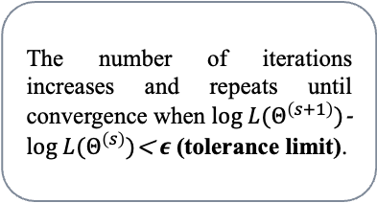
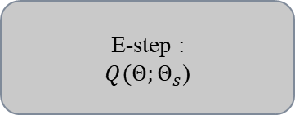
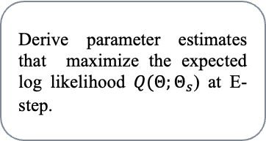
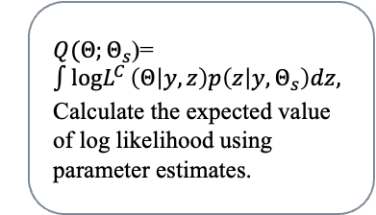
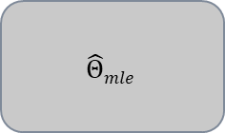
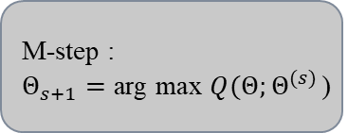
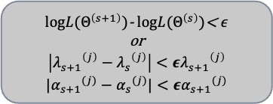
Introduction
- Competing risk models
Purpose of study
- EM vs BFGS
Method
– MLE / EM
Applications
- 2 Failure modes / 3 Failure modes
Conclusion
EM Algorithm
A general iterative approach for computing the MLE of parametric models when there are no closed-form ML estimates, or the data are incomplete.
The advantage is that it solves a difficult incomplete-data problem by constructing two easy steps.
s = s+1
No
E-step :
$Q(Θ;Θ_{s}$)
M-step :
$Θ_{s+1}=\text{arg} \text{max} Q(Θ;Θ^{(s)}$)
$logL(Θ^{\left(s+1\right)})$- $logL(Θ^{\left(s\right)})$< $ε$
or
$$\left|{λ_{s+1}}^{\left(j\right)}−{λ_{s}}^{\left(j\right)}\right|<ε{λ_{s+1}}^{\left(j\right)}$$
$$|{α_{s+1}}^{(j)}−{α_{s}}^{(j)}|<ε{α_{s+1}}^{(j)}$$
$$\hat{Θ}mle$$
Yes
1
2
3
4
$Q(Θ;Θ_{s}$)=$\int{logL^{C}}\left(Θ | y,z\right)p\left(z | y,Θ_{s}\right)dz,$
Calculate the expected value of log likelihood using parameter estimates.
Derive parameter estimates that maximize the expected log likelihood $Q(Θ;Θ_{s}$) at E-step.
The number of iterations increases and repeats until convergence when $log L(Θ^{\left(s+1\right)})$- $log L(Θ^{\left(s\right)})$< $ε$ (tolerance limit).
When the convergence criterion is reached, the EM sequence is done.
Park, C., & Lee, S. B. (2012) Parameter estimation from censored samples using the expectation-maximization algorithm
Department of Industrial Engineering,
Pusan National University
EM알고리즘을 이용한 기계부품의 고장 원인 및 신뢰성 분석
/ 14
Notes:
사용자 위치를 N 분할을 이용한 예측
Step 1 A=1 → ($\frac{1}{2},\frac{1}{2}$) (사각형의 중심 좌표, Cell 개수 = $1^{2}$ )
Step 2 A=2 → ($\frac{1}{4},\frac{1}{4}$), ($\frac{3}{4},\frac{1}{4}$), ($\frac{1}{4},\frac{3}{4}$), ($\frac{3}{4},\frac{3}{4}$) Cell 개수 = $2^{2}$
Step 3 A=3 → ($\frac{1}{6},\frac{1}{6}$), ($\frac{1}{6},\frac{3}{6}$), ($\frac{1}{6},\frac{5}{6}$), ($\frac{3}{6},\frac{1}{6}),\text{(}\frac{3}{6},\frac{3}{6}\text{), (}\frac{3}{6},\frac{5}{6}\text{), (}\frac{5}{6},\frac{1}{6}\text{), (}\frac{1}{6},\frac{3}{6}\text{)}$,($\frac{5}{6},\frac{5}{6}$) Cell 개수 = $3^{2}$
Step n A=n → ($\frac{1}{2n},\frac{1}{2n}$), … ,($\frac{2n−1}{2n},\frac{2n−1}{2n}$) Cell 개수 = $n^{2}$

Slide 10
Introduction
- Competing risk models
Purpose of study
- EM vs BFGS
Method
– MLE / EM
Applications
- 2 Failure modes / 3 Failure modes
Conclusion
2 Failure modes data
3 Failure modes data
30 observations of devices from a field-tracking study of a large system.
Failure modes : Censoring(0), Surge(1), Wear(2)
8 observations of complete data from a pneumatic cylinder(system)
Failure modes : Leak(A), Pressure(B), Speed(C)
Competing failure mode with 2 failure mode and censoring data
Interval Time(Cycle) | 300,000 | 300,000 | 2,000 | 261,000 | 293,000 | 88,000 | 247,000 | 28,000 | 143,000 | 300,000
Failure mode | 0 | 0 | 1 | 1 | 2 | 1 | 1 | 1 | 1 | 0
Interval Time(Cycle) | 23,000 | 300,000 | 80,000 | 245,000 | 266,000 | 275,000 | 13,000 | 147,000 | 23,000 | 181,000
Failure mode | 1 | 0 | 1 | 2 | 2 | 2 | 1 | 2 | 1 | 2
Interval Time(Cycle) | 30,000 | 65,000 | 10,000 | 300,000 | 173,000 | 106,000 | 300,000 | 300,000 | 212,000 | 300,000
Failure mode | 1 | 1 | 1 | 0 | 1 | 1 | 0 | 0 | 2 | 0
Competing failure mode with 3 failure mode
Sample Number | 1 | 2 | 3 | 4 | 5 | 6 | 7 | 8
Interval Time(Cycle) | 2,000,000 | 3,000,000 | 5,000,000 | 1,000,000 | 4,000,000 | 1,000,000 | 5,000,000 | 3,000,000
Failure mode | B | A | B | B | C | A | B | C
Chang, M. S., Choi, B. O., Kang, B. S., Park, J. W. and Lee, C. S., (2013) Reliability Analysis of a Mechanical Component with Multiple Failure modes, Trans. Korean. Soc. Mech. Eng. A, 37(9), pp. 1169~1174.
Meeker W.Q. and Escobar L.A., (1998) Statistical Methods for Reliability Data, John Wiley & Sons, Inc.
Department of Industrial Engineering,
Pusan National University
EM알고리즘을 이용한 기계부품의 고장 원인 및 신뢰성 분석
/ 14
Notes:
사용자 위치를 N 분할을 이용한 예측
Step 1 A=1 → ($\frac{1}{2},\frac{1}{2}$) (사각형의 중심 좌표, Cell 개수 = $1^{2}$ )
Step 2 A=2 → ($\frac{1}{4},\frac{1}{4}$), ($\frac{3}{4},\frac{1}{4}$), ($\frac{1}{4},\frac{3}{4}$), ($\frac{3}{4},\frac{3}{4}$) Cell 개수 = $2^{2}$
Step 3 A=3 → ($\frac{1}{6},\frac{1}{6}$), ($\frac{1}{6},\frac{3}{6}$), ($\frac{1}{6},\frac{5}{6}$), ($\frac{3}{6},\frac{1}{6}),\text{(}\frac{3}{6},\frac{3}{6}\text{), (}\frac{3}{6},\frac{5}{6}\text{), (}\frac{5}{6},\frac{1}{6}\text{), (}\frac{1}{6},\frac{3}{6}\text{)}$,($\frac{5}{6},\frac{5}{6}$) Cell 개수 = $3^{2}$
Step n A=n → ($\frac{1}{2n},\frac{1}{2n}$), … ,($\frac{2n−1}{2n},\frac{2n−1}{2n}$) Cell 개수 = $n^{2}$

Slide 11
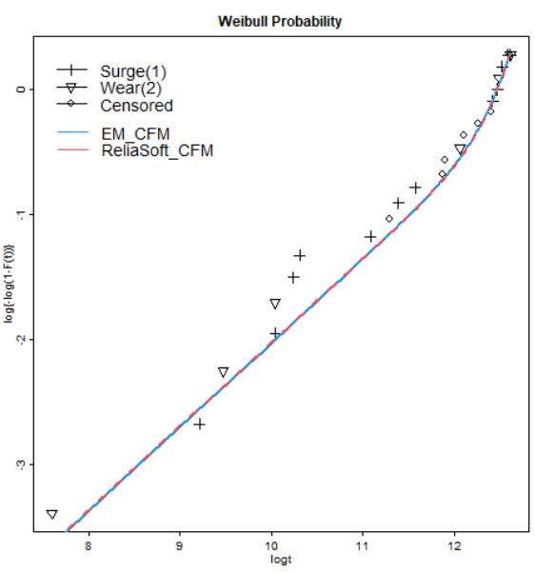
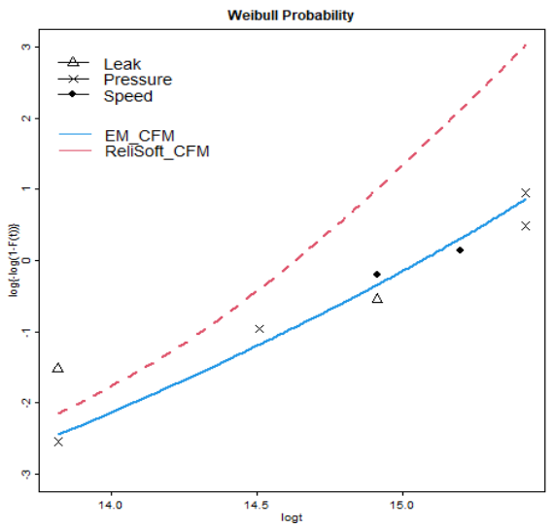
Introduction
- Competing risk models
Purpose of study
- EM vs BFGS
Method
– MLE / EM
Applications
- 2 Failure modes / 3 Failure modes
Conclusion
Estimation of Parameters by 2 Failure mode
Reliability Parameter | Failure mode 1 (Surge) |  | Failure mode 2 (Wear)
 | EM | ReliaSoft | EM | ReliaSoft
α(shape) | 0.671 | 0.670 | 4.337 | 4.490
η(scale) | 449,442 | 449,430 | 340,379 | 340,380
Estimation of Parameters by 3 Failure mode
Reliability Parameter | Failure mode A (Leak) |  | Failure mode B (Pressure) |  | Failure mode C (Speed)
 | EM | ReliaSoft | EM | ReliaSoft | EM | ReliaSoft
α(shape) | 1.33 | 1.35 | 2.27 | 4.25 | 3.77 | 3.97
η(scale) | 8,850,255 | 5,806,500 | 4,657,881 | 2,660,800 | 5,444,598 | 3,316,600
Comparison of EM and ReliaSoft Log likelihood and MSE by 2 Failure modes
 | Log likelihood | MSE× 10³
EM | -317.293 | 0.831
ReliaSoft | -317.519 | 0.855
Comparison of EM and ReliaSoft Log likelihood and MSE by 3 Failure modes
 | Log likelihood | MSE× 10³
EM | -132.363 | 4.802
ReliaSoft | -175.608 | 71.87
Chang, M. S., Choi, B. O., Kang, B. S., Park, J. W. and Lee, C. S., (2013) Reliability Analysis of a Mechanical Component with Multiple Failure modes, Trans. Korean. Soc. Mech. Eng. A, 37(9), pp. 1169~1174.
Department of Industrial Engineering,
Pusan National University
EM알고리즘을 이용한 기계부품의 고장 원인 및 신뢰성 분석
/ 14
Notes:
사용자 위치를 N 분할을 이용한 예측
Step 1 A=1 → ($\frac{1}{2},\frac{1}{2}$) (사각형의 중심 좌표, Cell 개수 = $1^{2}$ )
Step 2 A=2 → ($\frac{1}{4},\frac{1}{4}$), ($\frac{3}{4},\frac{1}{4}$), ($\frac{1}{4},\frac{3}{4}$), ($\frac{3}{4},\frac{3}{4}$) Cell 개수 = $2^{2}$
Step 3 A=3 → ($\frac{1}{6},\frac{1}{6}$), ($\frac{1}{6},\frac{3}{6}$), ($\frac{1}{6},\frac{5}{6}$), ($\frac{3}{6},\frac{1}{6}),\text{(}\frac{3}{6},\frac{3}{6}\text{), (}\frac{3}{6},\frac{5}{6}\text{), (}\frac{5}{6},\frac{1}{6}\text{), (}\frac{1}{6},\frac{3}{6}\text{)}$,($\frac{5}{6},\frac{5}{6}$) Cell 개수 = $3^{2}$
Step n A=n → ($\frac{1}{2n},\frac{1}{2n}$), … ,($\frac{2n−1}{2n},\frac{2n−1}{2n}$) Cell 개수 = $n^{2}$

Slide 12
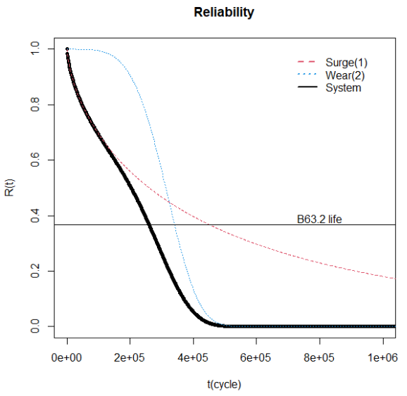
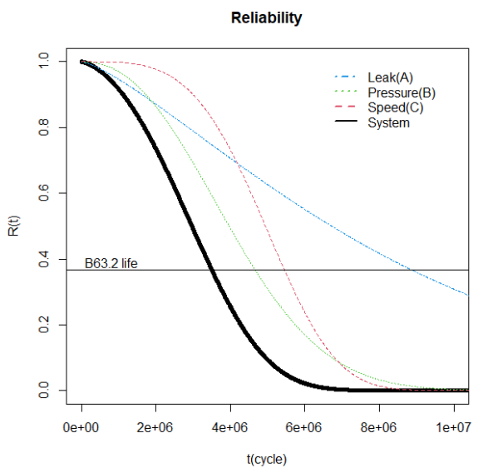
Introduction
- Competing risk models
Purpose of study
- EM vs BFGS
Method
– MLE / EM
Applications
- 2 Failure modes / 3 Failure modes
Conclusion
Bx life and MTTF in 2 failure modes
Cycle | Failure mode 1 (Surge) | Failure mode 2 (Wear) | System
𝐵₁ | 473 | 117,855 | 473
𝐵₅ | 5,374 | 171,616 | 5,373
𝐵₁₀ | 15,709 | 202,597 | 15,709
𝐵_{63.2} | 449,442 | 340,379 | 259,496
MTTF | 593,419 | 309,958 | 196,003
Bx life and MTTF in 3 failure modes
 | Failure mode A (Leak) | Failure mode B (Pressure) | Failure mode C (Speed) | System
𝐵₁ | 278,507 | 613,892 | 1,607,090 | 250,475
𝐵₅ | 948,586 | 1,258,732 | 2,476,320 | 727,239
𝐵₁₀ | 1,629,773 | 1,728,423 | 2,997,293 | 1,116,713
𝐵_{63.2} | 8,850,255 | 4,657,881 | 5,444,598 | 3,495,544
MTTF | 8,137,733 | 4,125,929 | 4,918,588 | 3,013,835
Department of Industrial Engineering,
Pusan National University
EM알고리즘을 이용한 기계부품의 고장 원인 및 신뢰성 분석
/ 14

Slide 13
Introduction
- Competing risk models
Purpose of study
- EM vs BFGS
Method
– MLE / EM
Applications
- 2 Failure modes / 3 Failure modes
Conclusion
1. EM Algorithm 과 기존 방법 간의 비교
EM 알고리즘은 likelihood 함수가 unimodal의 경우 MLE는 global maximum이 되는 것을 보장
위의 사례 연구에서는 EM 알고리즘을 사용한 경우 MSE 값이 최대 10배 이상 차이 남
기존의 분석 도구인 ReliaSoft는 MLE 가 최적화되어 있다고 보기 힘듦
고장 모드가 늘어날수록 파라미터의 수가 늘어나 MLE 수식의 복잡성이 증가
→ EM 알고리즘 형태가 적합
2. Competing Failure Mode using EM Algorithm
직렬 시스템의 경우 한 부품의 고장 원인이 시스템 전체 수명에 큰 영향을 미침
시스템과 부품의 MTTF를 이용하여 신뢰도 향상을 위한 시스템-부품 관계 분석 가능
Department of Industrial Engineering,
Pusan National University
EM알고리즘을 이용한 기계부품의 고장 원인 및 신뢰성 분석
/ 14

Slide 14
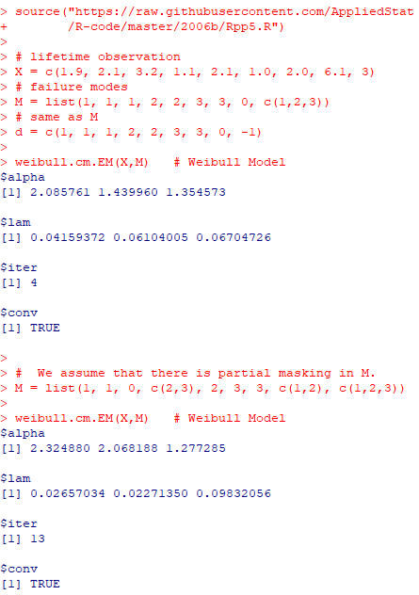
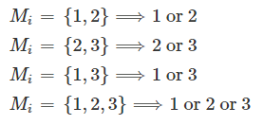
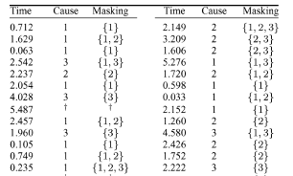

Introduction
- Competing risk models
Purpose of study
- EM vs BFGS
Method
– MLE / EM
Applications
- 2 Failure modes / 3 Failure modes
Further Work
Masking Data
Partial masking data
Complete masking data
Simulation example
Simulation result
R language Usage
https://raw.githubusercontent.com/AppliedStat/R-code/master/2006b/Rpp5.R
C. Park, (2005) Parameter estimation of incomplete data in competing risks using the EM algorithm, IEEE Transactions on Reliability.
Department of Industrial Engineering,
Pusan National University
EM알고리즘을 이용한 기계부품의 고장 원인 및 신뢰성 분석
/ 14

